Slide 1

Global CSS Scope – Circumvent problems
Intro
BEM CSS Modules CSS in JS Shadow DOM
Angular View Encapsulation
Approx. 30 min – Hopefully!!
ALEXANDER Silberschneider
@silberxander
© CC BY-NC-SA 3.0
Notes:
Intro – I‘ll explain what this global scope thing is all about and the issues we may have to tackle with that
Different approaches on how to circumvent global scope issues

Slide 2
Global CSS Scope
Circumvent issues
Notes:
Scope = Is an area in which certain program logic applies – in our case CSS rules – global by nature
The scope of „plain“ CSS always spans over the whole HTML document
This same concept has existed since the inception of CSS
In general, cascading rules to the whole HTML structure is just what had been intended, hence the name
Following I‘ll show you some short examples about what problems could arise from that
Frankly, some of these examples may seem a bit far-fetched, but I‘d intended to keep the intro as short as possible

Slide 3
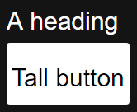
Base selector side effects
Intro
<h1>A heading</h1>
<button>
<h1>
Tall button
</h1>
</button>
h1 {
font-size: 24px;
}
Notes:
Base selector side effects – Intro
Here we got two elements - a standalone heading, but also a tall button - h1 font size tall!
The h1 selector with the font size rule applies to both the discrete heading itself and the h1 which is shown as the button content
When modifiying such a generic base selector this may have a broad impact everywhere we use h1 markup elements

Slide 4
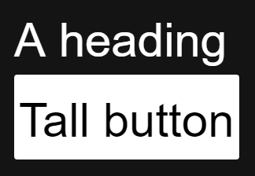
Base selector side effects - oops
Intro
<h1>A heading</h1>
<button>
<h1>
Tall button
</h1>
</button>
h1 {
font-size: 36px;
}
Notes:
Base selector side effects – The Problem
You may have guessed it, of course we‘d like to change the heading font size now
Because we have such a generic selector, this also – unintentionally? – affects the button font and actual size, „breaking“ the UI design
In a big project, not all affected elements may have been appropriately checked and adapted now
Most of the time nobody would dare to modify such a generic selector in a big project (Oh god what could be the side effects?!)

Slide 5
Base selector side effects – “solution”
Intro
<h1>A heading</h1>
<button>
<h1>
Tall button
</h1>
</button>
h1 {
font-size: 36px;
}
button h1 {
font-size: 24px;
}
Notes:
Base selector side effets – possible solution – increase specifity
Two classes have a higher specifiy as one class
CSS specifity is a moderately complex topic, it may not be really clear which rules apply when
If there is no agreement in the team about how to incorporate CSS specifity, this could lead to a uncontrolled growth in CSS selector numbers
This also may lead to ever more specific CSS rules and tons of obsolete CSS selectors

Slide 6
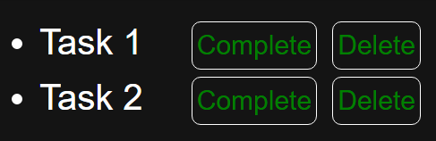
Match on child elements
Intro
<div class="tasks">
<ul class="task-items">
<li>
Task 1
<ul class="actions">
<li>Complete</li>
<li>Delete</li>
</ul>
</li>
<li>
Task 2
<ul class="actions">
<li>Complete</li>
<li>Delete</li>
</ul>
</li>
</ul>
</div>
.actions li {
color: green;
}
Notes:
Matches on child elements - Intro
Initially we have got a task list with action buttons to style
There is a CSS rule for those action buttons in the task items which defines a green text color

Slide 7
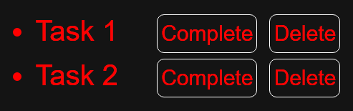
Red task list items – match on children
Intro
<div class="tasks">
<ul class="task-items">
<li>
Task 1
<ul class="actions">
<li>Complete</li>
<li>Delete</li>
</ul>
</li>
<li>
Task 2
<ul class="actions">
<li>Complete</li>
<li>Delete</li>
</ul>
</li>
</ul>
</div>
.actions li {
color: green;
}
.tasks .task-items li {
color: red;
}
Notes:
Match on child elements - Problem
Now we‘d like to change the design of the task list items so that they have a red text color
Unintentional side effect: The buttons now also have the same text color
Reason: Match on child elements through the new selector, which has a higher specifity because it include an additional class
Could happen easily in a real world scenario if you include third party components as child elements somewhere in your project

Slide 8
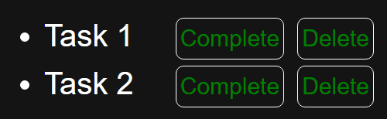
Match on child elements – bad solution
Intro
<div class="tasks">
<ul class="task-items">
<li>
Task 1
<ul class="actions">
<li>Complete</li>
<li>Delete</li>
</ul>
</li>
<li>
Task 2
<ul class="actions">
<li>Complete</li>
<li>Delete</li>
</ul>
</li>
</ul>
</div>
.actions li {
color: green !important;
}
.tasks .task-items li {
color: red;
}
Notes:
Matches on child elements – „Solution“
Using the „nuclear“ !important CSS rule modificator
Every other rule is overwritten, well at least if those other rules aren‘t „!important“ as well (then the usual css specifity algorithm kicks back in – more confusion)
Harry Roberts (csswizardry.com) says that „!important“ should only be used proactively and never reactively (e.g. to define a CSS rule which should always take precedence over any other matching rule), I‘d prefer to never use it at all, it could possibly always lead to later issues

Slide 9
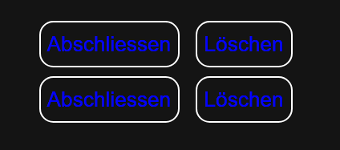
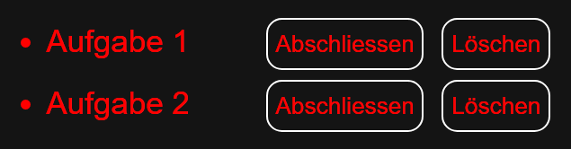
Match on child elements - better solution
Intro
<div class="tasks">
<ul class="task-items">
<li>
Task 1
<ul class="actions">
<li>Complete</li>
<li>Delete</li>
</ul>
</li>
<li>
Task 2
<ul class="actions">
<li>Complete</li>
<li>Delete</li>
</ul>
</li>
</ul>
</div>
.actions li {
color: blue;
}
.tasks .task-items > li {
color: red;
}
Notes:
Matches on child elements – a better solution
Restrict selector match for red color to task list item LI element itself

Slide 10
Global CSS Scope
Intro
Issues Roundup
Notes:
Global CSS Scope – which problems could arise
Issues with the layout of 3rd party widgets because of own selectors
Increasing effort to check if styles don‘t break upon modification in growing projects
Ever more specific selectors or usage of the „!important“ modifier to make sure that rule overrides work (hard to understand and maintain)
Almost every other programming language aims for a modular approach – or finds workarounds to mimic modularity, how to do this with CSS?

Slide 11

BEM
Naming convention (and more)
Notes:
Block – Element – Modifier
BEM is not a tool, its a methodology for a unified semantic model, which applies to HTML, Styles, Code and UX
In the next minutes we‘ll concentrate on the naming convention side of things only
Aims for easier readable CSS code, promotes reuse and improves maintainability
How? By dividing parts of the user interface into independent blocks (the B in BEM)

Slide 12
Block, element, modifier
.title {}
.title__subline {}
.title__author {}
.title--xlarge {}
.title__subline--is-hidden {}
Notes:
Introducing: Block
Functionally independent, reusable component – in our case, the title block
Name of the Block describes its purpose, not its style or state
A block in BEM could include elements, acting as their parent

Slide 13
Block, element, modifier
BEM
.title {}
.title__subline {}
.title__author {}
.title--xlarge {}
.title__subline--is-hidden {}
Notes:
Introducing: Element
An element is depending on a block as its parent, it couldn‘t exist on its own (subline, author)
Name includes block name, separated through two underscores
An element in the BEM hierarchy couldn‘t be a parent of an other element (this doesn‘t apply to the HTML structure, as we‘ll see later)

Slide 14
Block, element, modifier
BEM
.title {}
.title__subline {}
.title__author {}
.title--xlarge {}
.title__subline--is-hidden {}
Notes:
Introducing: Modifier
Belongs to a block or an element
Describes a certain state and/or a specific style, which constitute a deviation to the default state or style
The modifier selector never exists on its own
Just for information, these examples show the so called „double-dash“ style syntax, there are other possibilities as well
Until now we just saw the CSS, but there is already an idea forming in our head about how the HTML could look like

Slide 15
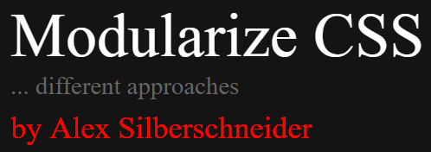
HTML
BEM
<div class="title title--xlarge">
Modularize CSS
<div class="title__subline">
… different approaches
</div>
<div class="title__author">
by Alex Silberschneider
</div>
</div>
Notes:
HTML for the selector samples
Because of the structure of the CSS it‘s easy to conclude on how the HTML will look like and vice versa
Modification of the structure of the HTML doesn‘t break what was laid forth as the Block – Element structure, selector matches will stay intact
Example: move the author element into the subline element
This also showcases that elements could be nested in the HTML as needed

Slide 16
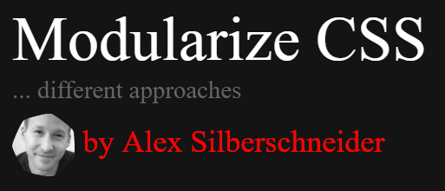
HTML
BEM
<div class="title title--xlarge">
Modularize CSS
<div class="title__subline">
… different approaches
</div>
<div class="title__author">
<div class=“avatar">
<div class=“avatar__thumb"></div>
</div>
by Alex Silberschneider
</div>
</div>
Notes:
HTML for the selector samples
Other blocks could be inserted into this block as desired
E.g. an avatar block, but this would bring its own selectors

Slide 17
No nesting
BEM
<div class="title__subline">
Subline text
<div class="title__subline__date">
01.12.2017
</div>
</div>
Notes:
Prevent nesting of Block – Element – Element in the BEM selector
Most likely you would mix the HTML structure with the semantical meaning
Makes it harder to maintain when you start to move elements in the HTML structure
Most likely you‘d want to introduce a new block instead

Slide 18
Example where Nesting is „OK“
BEM
.grid--is-editing .grid__cell {
border: 1px solid black;
}
Notes:
Certain kinds of nesting are OK but should be used sparingly
In our example we nest a block selector with a certain modifier with the block element
For such a use case this is the most effective way to have the rule apply

Slide 19
BEM benefits
BEM
Notes:
BEM Benefits
Precise semantics, relationship easy to recognize, simplifies communication in a team
CSS is not directly coupled with HTML structurally
More confidence when introducing changes, minimize side effects
Easily locate selectors which need to be modified, no CSS specifity to worry about
Could use this on little projects from the start as well
BEM Issues
Many classes, long class names, everyone should/must adhere to the naming convention, could be hard sometimes ;)

Slide 20
CSS Modules
Modularization in the build process
Notes:
CSS Modules Intro
CSS Modules = roughly speaking, CSS files in which all class names are scoped locally instead of globally
This isn‘t an official spec or a browser implementation, its a step in the build / bundling process through a tool lik Webpack or Browserify
Build tool: Package application modules, tranformation and transpilation of source files (e.g. SASS to CSS, TypeScript to JavaScript etc.)
To emulate a local scope with CSS modules the source HTML and CSS need to be modified in the build process

Slide 21
Initial code
CSS Modules
<h1 class=“bigtitle">
A heading
</h1>
.bigtitle {
color: red;
font-size: 36px;
}
Notes:
Initial example, both plain HTML, CSS
We got to rewrite this to be able to use CSS modules

Slide 22
Instead of HTML, Javascript + Template string
CSS Modules
import styles from "./styles.css";
element.innerHTML =
`<h1 class="${styles.bigtitle}">
A heading
</h1>`;
Notes:
Restructurizing the initial source files
The compoments HTML template is now defined as an ES6 template string
Styles will be „imported“ from the CSS File
For those of you familiar with ES6, this seems a little bit strange – how could we import module content from a CSS file??
This is a little trick where CSS modules come into play, with Webpack the CSS modules loader parses the underlying CSS file and maps the individual classes to properties of the imported object
Class names which did exist in the original CSS file will be replaced with unique string keys, these are available as values behind the properties of the imported object, e.g. “styles.bigtitle”

Slide 23
Resulting output
CSS Modules
<h1 class="_styles__bigtitle_471156789">
A heading
</h1>
._styles__bigtitle_471156789 {
color: red;
font-size: 3rem;
}
Notes:
CSS Modules resulting output
After the build, the result consists of HTML and CSS again
The „bigtitle“ Selector has been replaced through a new unique string
CSS rules have been mapped to this new selector name
This means that selector always have „local scope“ with their templates
In our case you can recognize the original selector name, this is complete configurable though

Slide 24
React
CSS Modules
import React from 'react'
import styles from './styles.css'
export default class CoolTitle extends React.Component {
render() {
return (
<h1 className={styles.bigtitle}>{this.props.text}</h1>
)
}
}
Notes:
CSS Modules with React and JSX
For those of you who already wondered why on earth we‘d like to rewrite our markup to template strings
Much more elegant with JSX templates, almost looks like the markup itself

Slide 25
Angular
CSS Modules
import {Component} from '@angular/core';
import styles from './styles.css';
@Component({
'selector': 'my-component',
'template': `<h1 class="${styles.bigtitle}">
Big title
</h1>`
})
Notes:
Since we talked about React, what about Angular?
Well you COULD use webpack with the CSS Module loader with Angular (link to demo in appendix)
Since Angular 2.x+ there is a built in mechanism for component based styling called „ViewEncapsulation”
More on that later

Slide 26
CSS Modules benefits
CSS Modules
Notes:
CSS Modules benefits
CSS selector names freely defineable, no side effect
Styles are scoped locally per default, saves you many headaches
Plain CSS could be written, plain CSS goes to the browser
Makes sense in bigger projects – slightly overkill with little projects
Only really makes sense if you already could use some kind of templating for your UI framework

Slide 27
CSS in JS
Goodbye CSS! (NOT really)
Notes:
CSS in JS
Many different libraries, in general they use two different approaches
#1 appraoch emission of modular CSS via Javascript, Injection into good old CSS style blocks
#2 approach creation of inline style attributes on DOM elements with addtional JS event listeners to support pseudo states like :hover
Most well known #1 approach: Styled-components (React, ReactNative)
Most well known #2 aproach: Radium (React)
Writing styles in the different frameworks is quite diverse
Authoring approach #1: Write more or less plain CSS as ES6 template strings
Authoring approach #2: Define CSS selectors and rules as JS objects, property names are selector names or rule names

Slide 28
Aphrodite
CSS in JS
Notes:
Intro Aphrodite
Why Aphrodite: Chosen as an example b/c it is generally framework independent
Also generates style tag, injects styles as needed
Supports pseudo states, media queries, keyframe animations by generating „real CSS“

Slide 29

Aphrodite JS
CSS in JS
import {StyleSheet, css} from 'aphrodite'
const styles = StyleSheet.create({
bigtitle: {
color: 'red',
fontSize: '3rem',
backgroundColor: ‘transparent',
height: '2em',
':hover': {
color: 'white',
backgroundColor: ‘palevioletred'
}
}
});
const app = document.getElementById('app');
app.innerHTML = `
<h1 class="${css(styles.bigtitle)}">
A heading again!
</h1>`;
console.log(css(styles.bigtitle));
// "bigtitle_195i0wx"
Notes:
Aphrodite JS Sample
The first call to the „css“ mehtod injects the styles into the header block
Unuses declarations won‘t be injected

Slide 30

Aphrodite JS
CSS in JS
import {StyleSheet, css} from 'aphrodite'
const styles = StyleSheet.create({
bigtitle: {
color: 'red',
fontSize: '3rem',
backgroundColor: ‘transparent',
height: '2em',
':hover': {
color: 'white',
backgroundColor: ‘palevioletred'
}
}
});
console.log(css(styles.bigtitle));
// "bigtitle_195i0wx"
const app = document.getElementById('app');
app.innerHTML = `
<h1 class="${css(styles.bigtitle)}">
A heading again!
</h1>`;
Notes:
Aphrodite JS Sample
Hover style is a „real“ CSS declaration

Slide 31
Aphrodite CSS
CSS in JS
<style type="text/css" data-aphrodite="">
.bigtitle_wnu5ld {
background-color:red !important;
color:blue !important;
height:2em !important;
}
.bigtitle_wnu5ld:hover {
color:white !important;
background-color:black !important;
}
</style>
Notes:
Aphrodite JS Sample – Output
Used declarations were generated as CSS
„!important“ modificator is generated per default, the documentation describes the reasonas „This is intended to make integrating with a pre-existing codebase easier.” – this could be turned off though

Slide 32
CSS in JS roundup
Notes:
CSS in JS roundup
Mostly realized via CSS injection, the final outcome is very similar to what CSS modules does
Enables easy bundling of a compoments JS and CSS in the same file
Many CSS in JS frameworks also support server side rendering out of the box
„Preprocessing“ has to be done / could be done in JavaScript instead of one of the usual preprocessors like LESS/SASS – finally with a „real programming language“ now ;) – this also means that style writers aren‘t restricted to what is possible with LESS/SASS
Syntax for writing styles feels unfamiliar at first, because it is always just a wrapper for real CSS
In the appendix you can find a link to a github repository where someone has made it their task to list different CSS in JS implementations in a well arranged comparison

Slide 33
Shadow DOM
A future possibility
Notes:
Shadow DOM – what‘s that?
In functionality it‘s comparable to an IFRAME – it enables completely decoupled content within the rest of the page
If you already had a look at web components, you surely have heard of it
Shadow DOM enables the encapsulation of CSS and HTML without any further tools natively through the browser
This is already being used in modern browser e.g. To encapsulate the HTML5 video player controls when using video tags

Slide 34
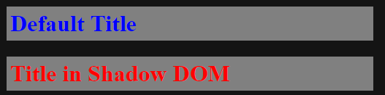
Simple example
Shadow DOM
const myElement = document.querySelector('.my-host');
const shadow = myElement.attachShadow({
mode: 'closed'
});
shadow.innerHTML = `
<style>
h1 {
color: red;
}
</style>
<h1>Title in Shadow DOM</h1>
`;
HTML
<h1>Default Title</h1>
<div class="my-host"></div>
CSS
h1 {
color: blue !important;
}
Notes:
Shadow DOM example
The current spec draft doesn‘t provide for any inheritance of styles into the shadow DOM part by its surrounding context (as opposing to the initial v0 draft where this was still possible if explicitly enabled)
As you can see in the example the shadow DOM part is not being affected by selectors of the surrounding HTML

Slide 35
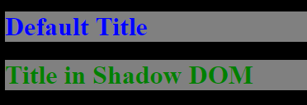
How to apply styles
Shadow DOM
let myElement = document.querySelector('.my-host');
let shadow = myElement.attachShadow({
mode: 'closed'
});
shadow.innerHTML = `
<style>
h1 {
color: var(--my-custom-h1-color, red);
}
</style>
<h1>Title in Shadow DOM</h1>
`;
HTML
<h1>Default Title</h1>
<div class="my-host"></div>
CSS
h1 {
color: blue !important;
}
html {
--my-custom-h1-color: green;
}
Notes:
How to apply theming to e.g. 3rd Party widgets using Shadow DOM
CSS custom properties / CSS variables are accessible in Shadow DOM css
3rd Party widget must define which properties are available for theming

Slide 36
Shadow DOM roundup
Support 56% http://caniuse.com/#feat=shadowdomv1
Notes:
Shadow DOM roundup
Enables real encapsulation of CSS
Still in active development – spec could also still change!
Browser support currently still at only 56% see http://caniuse.com/#feat=shadowdomv1, Chrome, Safari, Opera, NO Firefox (in dev), NO IE/Edge (under consideration)
Polyfills slow, can‘t be recommended thus
Could be used as a progressive enhancement, fallback to iframe injection - Example: Twitter timeline: tweets

Slide 37
Angular view encapsulation
Two Built in approaches
Notes:
Since Angular 2+ Angular includes a mechanism called view encapsulation, two approaches available

Slide 38

„Emulated“ - default
Angular
import { Component, ViewEncapsulation } from '@angular/core';
@Component({
selector: 'app-first-component',
templateUrl: './first-component.component.html',
styleUrls: ['./first-component.component.css'],
encapsulation: ViewEncapsulation.Emulated
})
export class FirstComponentComponent {}
h1 {
color: red;
}
Notes:
Component declaration + css
Could also leave out declaration of Emulated because it is the default value
Won‘t affect other components

Slide 39
„Emulated“ – how does this work
Angular
<h1 _ngcontent-c1="">
First component H1
</h1>
h1[_ngcontent-c1] {
color: red;
}
Notes:
Every element of component gets attribute
Selector restrained to elements with matching attribute

Slide 40
„Native“ – Shadow DOM
Angular
import { Component, ViewEncapsulation } from '@angular/core';
@Component({
selector: 'app-first-component',
templateUrl: './first-component.component.html',
styleUrls: ['./first-component.component.css'],
encapsulation: ViewEncapsulation.Native
})
export class FirstComponentComponent {}
Notes:
Use Shadow DOM by simply switching encapsulation mode

Slide 41
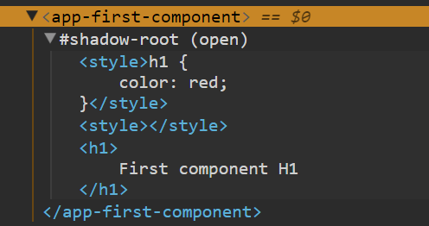
„Native“ – how does this work
Angular
import { Component, ViewEncapsulation
} from '@angular/core';
@Component({
selector: 'app-root',
templateUrl: './app.component.html',
styleUrls: ['./app.component.css'],
encapsulation: ViewEncapsulation.Native
})
export class AppComponent {}
Notes:
Use Shadow DOM by simply switching encapsulation mode
Generates component within Shadow DOM host
As said earlier: Needs polyfills with certain browsers

Slide 42
Many possibilities
Closing
Every method has its pros and cons
Notes:
Also depends highly on the support with your primary UI framework
In the end - mix and match approaches to suit your needs

Slide 43
Thank you for listening!
Closing

Slide 44
Appendix
Closing

Slide 45
Link CSS in general
https://philipwalton.com/articles/side-effects-in-css/
http://thesassway.com/intermediate/avoid-nested-selectors-for-more-modular-css
http://www.standardista.com/css3/css-specificity/
http://thesassway.com/beginner/the-inception-rule
https://csswizardry.com/2012/11/code-smells-in-css/

Slide 46
Links BEM
https://en.bem.info/
https://css-tricks.com/bem-101/
https://csswizardry.com/2013/01/mindbemding-getting-your-head-round-bem-syntax/
https://www.smashingmagazine.com/2016/06/battling-bem-extended-edition-common-problems-and-how-to-avoid-them/
https://www.sitepoint.com/bem-smacss-advice-from-developers/
https://medium.com/@stowball/bemantic-dry-like-you-mean-it-133ea3843d98
https://www.smashingmagazine.com/2014/07/bem-methodology-for-small-projects/
https://mattstauffer.co/blog/organizing-css-oocss-smacss-and-bem/
https://csswizardry.com/2015/03/more-transparent-ui-code-with-namespaces/

Slide 47
Links CSS Modules
https://css-tricks.com/css-modules-part-1-need/ +2+3 (Attention: Breaking webpack changes in the tutorial! Ask me..)
https://glenmaddern.com/articles/css-modules
https://www.sitepoint.com/understanding-css-modules-methodology/
https://github.com/nkbt/ng-modular
https://vuejs.org/v2/guide/single-file-components.html
https://github.com/joaogarin/css-modules-angular2

Slide 48
Links CSS in JS
https://github.com/MicheleBertoli/css-in-js
https://medium.freecodecamp.org/css-in-javascript-the-future-of-component-based-styling-70b161a79a32
http://engineering.khanacademy.org/posts/aphrodite-inline-css.htm
https://github.com/airbnb/javascript/tree/master/css-in-javascript
https://www.styled-components.com/docs
https://github.com/threepointone/glamor
https://medium.com/@gajus/stop-using-css-in-javascript-for-web-development-fa32fb873dcc ;)

Slide 49
Links Shadow DOM
http://caniuse.com/#feat=shadowdomv1
https://css-tricks.com/playing-shadow-dom/
https://frontend.namics.com/2014/05/27/web-components-shadow-dom/
https://developers.google.com/web/fundamentals/architecture/building-components/shadowdom
https://www.smashingmagazine.com/2016/12/styling-web-components-using-a-shared-style-sheet/
https://www.polymer-project.org/2.0/start/first-element/step-5

Slide 50
Pens
https://codepen.io/silberxander/

